Slide 1
Secure Transportation Management System using Edge Computing for smart city: Challenges and Future Implementations
Instructor: Annajiat Alim Rasel
RA: Humaion Kabir Mehedi
ST: Ehsanur Rahman Rhythm
Team No: 30
Group Members:
Shishir Kumar Das - 23366019
Maymuna Rukaiya - 23266019
Khairun Nisa - 23266001
Mahdi Hossain - 20301194

Slide 2
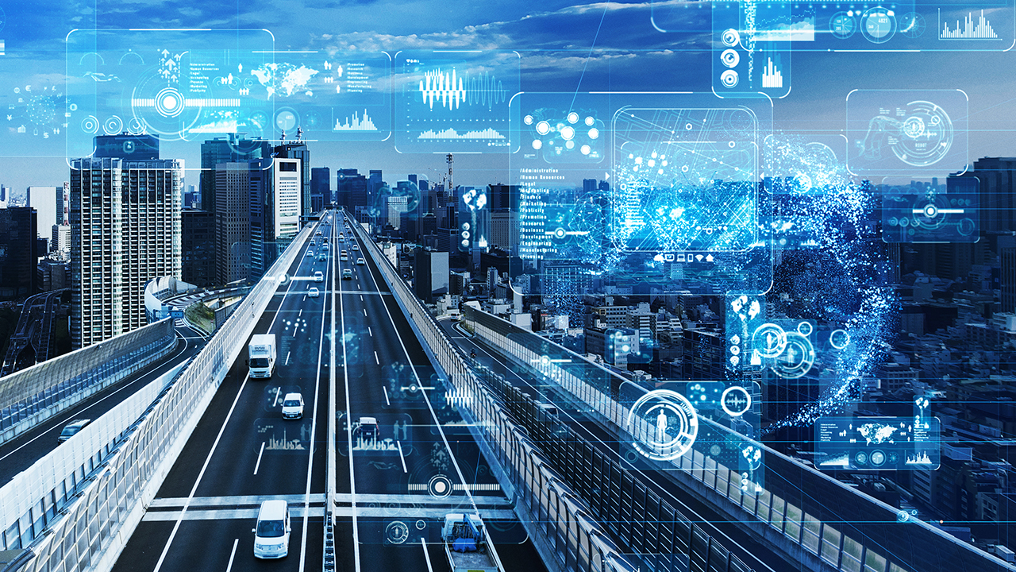
Abstract
The increasing levels of urbanisation and population
In response, the idea of a "smart city" makes use of technology
An essential element of a smart city is a secure transport management system
The difficulties and possible uses of edge computing
The research has the potential to enhance the standard of life for citizens of modern cities

Slide 3
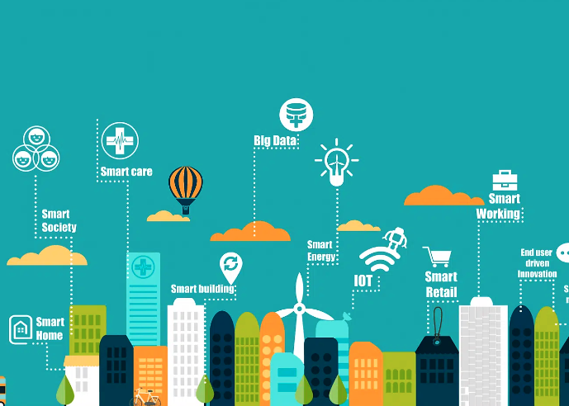
Introduction
Urbanization and population growth make transport network management challenging.
Smart cities use technology to improve service effectiveness and adapt to resident needs.
A secure transport management system is crucial for a smart city.
Edge computing can enhance transportation systems by enabling real-time data processing and decision-making.
Intelligent Transportation Systems (ITS) manage traffic flow, reduce congestion, and enhance safety.

Slide 4
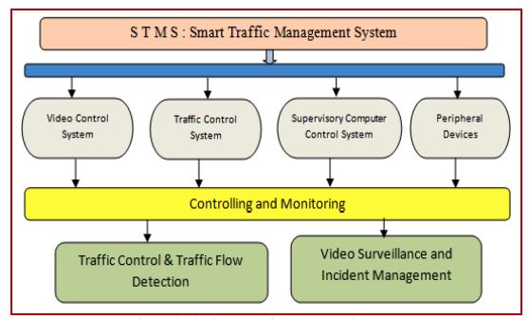
Introduction
Deep learning techniques are being used to predict autonomous vehicle behavior.
Edge computing can assist autonomous driving and provide real-time traffic information.
Challenges to incorporating edge computing into transport systems include resource management, interoperability, and data security.
Smart Transport Management Systems (STMS) are crucial for effective and secure commuting in smart cities.
STMS utilize technologies such as edge computing, IoT, and blockchain to manage traffic flow, reduce congestion, and enhance safety.

Slide 5
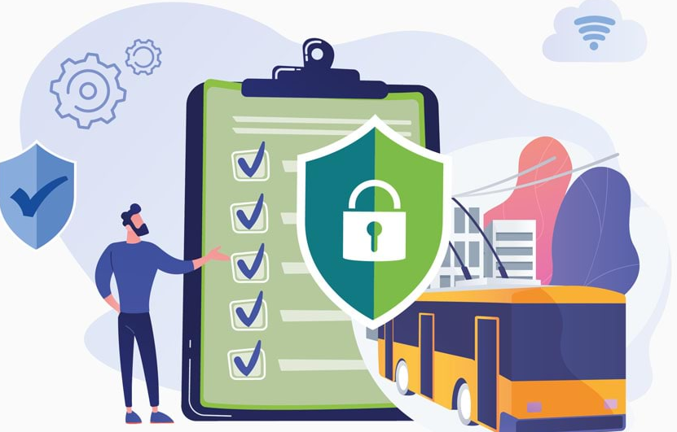
Literature Survey
Security Trends in the Transportation Industry by IBM X-Force Research report
Between March 1, 2015 and May 15, 2016, over 44 percent of attacks successful
Cyberattack on automobile equipped with a ”U-connect” in-vehicle networking device
Got the ability to remotely control a Jeep and drive it off the road
Faulty Mobileye EyeQ 3 device in Tesla vehicles
Turning 35 mile per hour road sign to an 85 mile per hour sign

Slide 6

Literature Survey
Hackers target Jeep Cherokee in 2018
Take control of the car’s steering, brakes, and engine gearbox using a Wi-Fi or cellular connection
Gigabit-speed networking to smart vehicle by Cisco
Broaden the scope of an assault on a smart vehicle due to higher bandwidth capabilities
14 security flaws in many BMW cars by Researchers
physical access to the car and remote vehicle hacking

Slide 7
Methodologies
4 Architecture we will use to model our edge computing system
Edge Computing Architecture
Blockchain for Data Integrity
Internet of Vehicles (IoV) Architecture
Zero Trust Security Model

Slide 8
Edge Computing Architecture:
Deploy edge computing devices on vehicles and at key roadside infrastructure points.
Implement local processing for real-time data such as traffic flow, vehicle health, and environmental conditions.
Enable local decision-making to improve system responsiveness.
Blockchain for Data Integrity
Use blockchain to create an immutable and tamper-resistant ledger for critical data.
Timestamp data entries on the blockchain to establish a transparent and traceable record of events.
Integrate smart contracts for automated and secure execution of predefined actions.

Slide 9
Internet of Vehicles (IoV) Architecture
Establish a vehicular communication network for seamless communication between vehicles and infrastructure.
Implement Vehicular Cloud Computing (VCC) to offload computational tasks to the cloud and enhance data sharing capabilities.
Use IoV for collaborative decision-making, such as dynamic route optimization and traffic management.
Zero Trust Security Model
Adopt a Zero Trust approach by verifying the identity of users, devices, and systems before granting access.
Implement strong authentication mechanisms for edge devices, vehicles, and users.
Employ micro-segmentation to restrict lateral movement within the TMS network.

Slide 10
Conclusion:
This paper examined some of the primary problems with edge computing caused by design flaws and how these problems may affect end devices.
Apart from side-channel attacks, protocol or implementation errors are the primary causes of problems in edge systems.
We determined that transportation system security needs to be improved based on the state of the art.
More investigation is needed into the IoV and edge computing paradigms.
Putting in place an appropriate framework will help achieve this.

Slide 11
Future Work:
In terms of future directions, the proposed system could be enhanced further by taking various features into the version like real-time data to drivers.
Future research will focus on dynamic traffic signal control functionality and performance in low-light environments or during extreme weather.
The system’s real-time implementation, which includes IoT security features in the communication layer, the architecture must be expanded to a whole end-to-end system with central server communication.

Slide 12
THANK YOU

